Slide 1
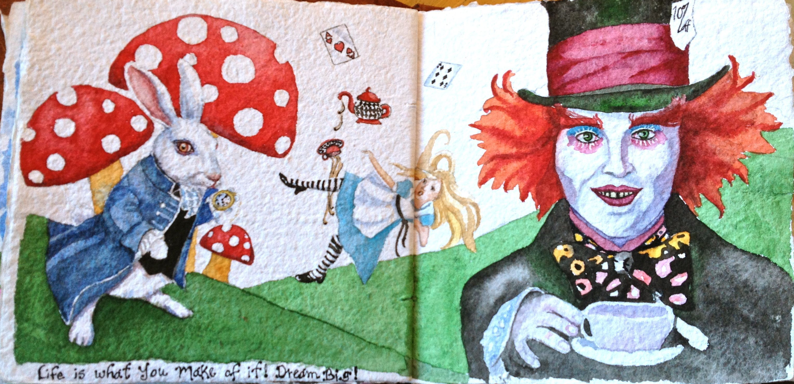
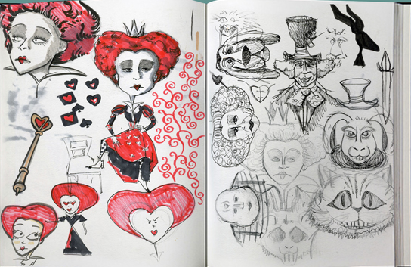
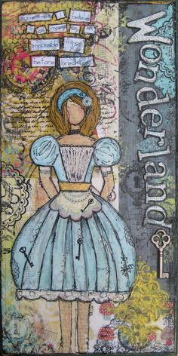
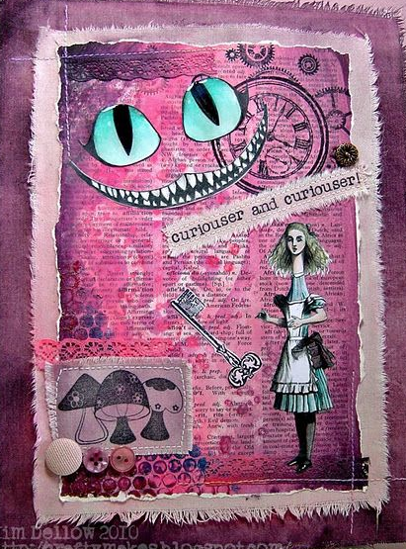
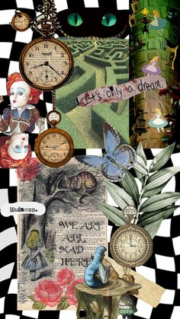
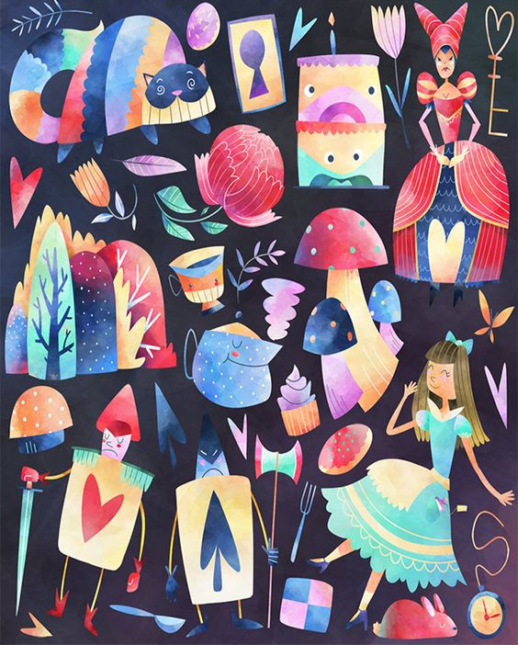
Textiles Transition Work - Your UNIT 1 title is:
“WONDERLAND”
TASKS TO COMPLETE:
Read one of the Lewis Caroll Books: Alice’s Adventures in Wonderland or Alice Through the Looking Glass.
2. Watch one or more of the Alice in Wonderland films (Disney’s or Tim Burton’s) and record things that interest you from the film You could make notes of parts of the book/film that have imagery you like, (e.g. roses, playing cards, tea party) and draw a few of these things in any media. You could also note down quotes or parts that are key in the books/film.
3. Collect images/objects related to the Wonderland theme.
You will use these to create a moodboard and draw from. Try to use a range of sources – not just the internet.
4. Collect bits and bobs to create unique pieces of work in your book. This will help you to develop your own personal style. In Year 12, you will be expected to not only explore with colours and techniques but texture as well. Collecting materials, (even if they are not textiles materials), will ensure that you have a variety of things to work with.
Think twice before throwing away unwanted clothing, costume jewellery and accessories– collect scraps or old materials, buttons, ribbon, beads, and fastenings to use for embellishments.
To create various textures in your work you can collect – bubble wrap, special paper, wrapping paper, newspaper/ magazine cuttings, envelopes, unwanted books and clothing tags.
EQUIPMENT LIST
In order to study Textiles you will need:
An A3 or A2 Folder to carry work in, Sketching Pencils, Colouring pencils, Fineliner pens, Good quality felt tips, Watercolour Palette and brushes, Scissors, a pair of fabric scissors and an embroidery kit for home use. Please have these for your first lesson in September.

